Slide 1



Development of a simulation environment for teleoperated surgical task
Faculty of Information Engineering, Computer Science and Statistics
M.Sc. in Artificial Intelligence and Robotics
AA 2016-2017
Professor:
Marilena Vendittelli
Alessandro De Luca
Presenter:
Aloise Irvin, Colosi Mirco, Gigli Andrea

Slide 2
Outline
Goal
Introduction and Motivations
Devices: Geomagic Touch & Kuka LWR 4+
Coupling and clutching
Kuka Cartesian control
Teleoperation principles
Soft tissue model
The simulation software
Simulations and results
Conclusions

Slide 3
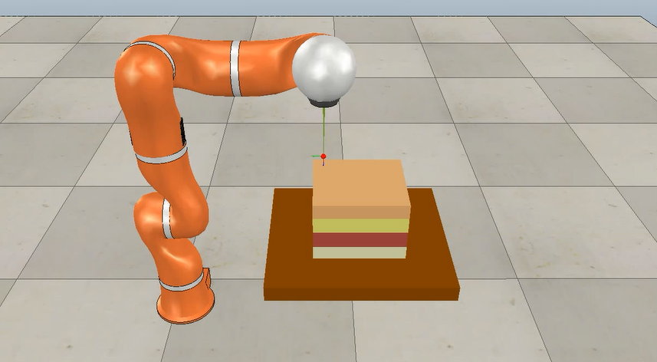
Goal
Realization of a simulative framework for:
Teleoperation task between real haptic device and virtual robot
Needle insertion task
Computation of haptic feedback

Slide 4
Introduction and motivations
Teleoperation = remote control
Master in the local site, Slave in the remote site
Motivation: command robot in far, dangerous, small/big environments
Telesurgery improves surgeon’s technical abilities (precision, dexterity, safety)
Needle insertion: definition and applications
Simulated needle insertion: cheap and safe

Slide 5
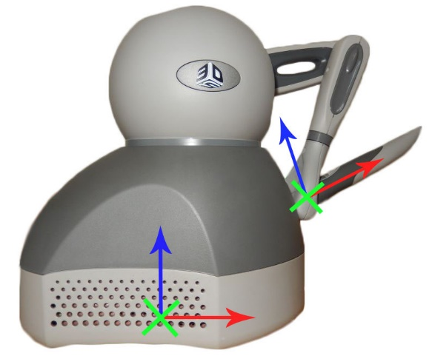
Devices: Geomagic Touch
Geomagic Touch by 3D Systems (previously Phantom Omni by SensAble Technologies)
6 joints: first 3 actuated, others 3 passive spherical wrist
Small dimensions, limited workspace 160 w x 120 h x 70 d mm
Maximum exertable linear force = 3.3N
2 buttons
Ethernet connectivity
Compatible with OpenHaptics Toolkit (3D Systems) and CHAI3D libraries.

Slide 6
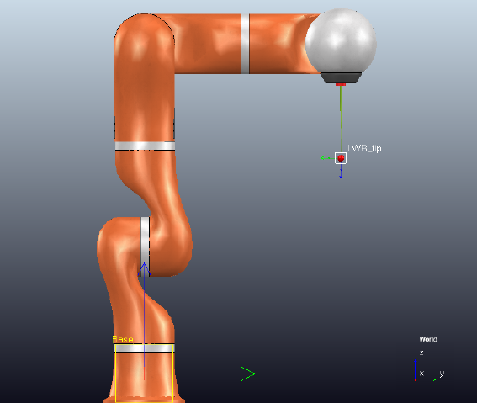
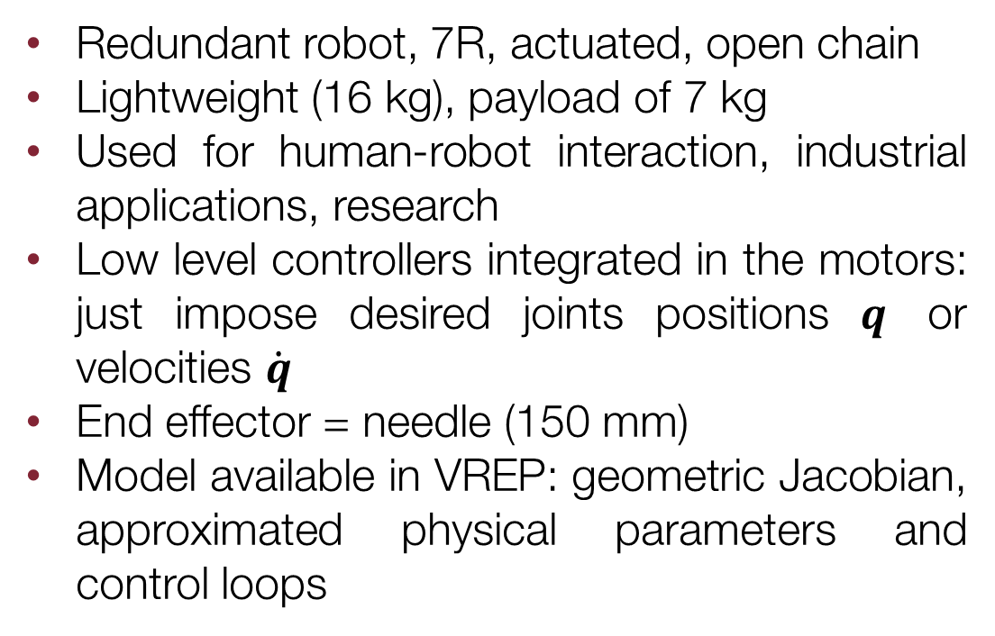
Devices: Kuka Lwr 4+ (aka kuka lbr 4+)
Redundant robot, 7R, actuated, open chain
Lightweight (16 kg), payload of 7 kg
Used for human-robot interaction, industrial applications, research
Low level controllers integrated in the motors: just impose desired joints positions $q$ or velocities $\dot{q}$
End effector = needle (150 mm)
Model available in VREP: geometric Jacobian, approximated physical parameters and control loops

Slide 7
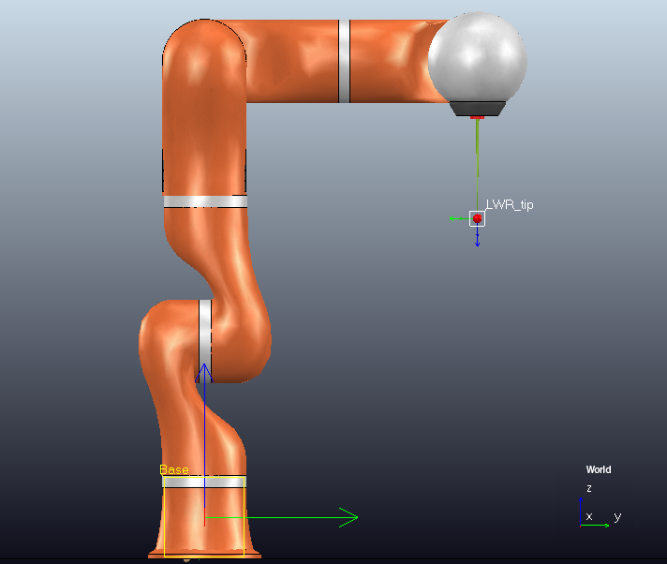

Master-slave frame mismatch
The frames of Geomagic Touch’s end effector and KUKA’s tool-tip do not coincide, so to guarantee coherent movements of the slave it is necessary to align them.
Fixed Offset between the frames
The $x$- axis of Geomagic’s pencil has to coincide to the $z$- axis of the KUKA’s tool-tip. This fixed rotational offset must always be added to have a intuitive teleoperation.

Slide 8
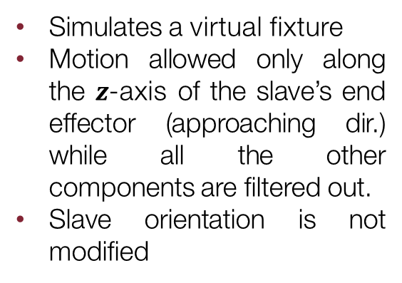
Workspace extension (1)
The first thing to underline is that master and slave do not have the same workspaces. A clutching mechanism is required to extend Geomagic limited workspace. This is done using the 3 buttons on the device.
Button 1
Button 2
Button 3
Fully releases the clutch between master and slave
Slave position is modified
Slave orientation is modified
Partially releases the clutch between master and slave
Slave position is not modified
Slave orientation is modified
Simulates a virtual fixture
Motion allowed only along the $z$-axis of the slave’s end effector (approaching dir.) while all the other components are filtered out.
Slave orientation is not modified

Slide 9
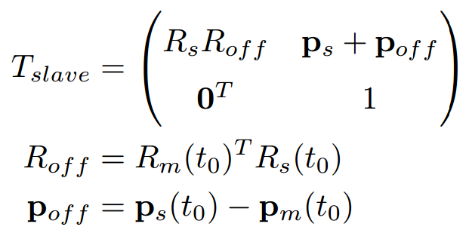
Workspace extension (2)
The software has to evaluate the offset between the current pose of slave’s end effector and the current master pose every time the user switches button.
In this way it is possible to command correctly and in a more intuitive way the slave through the haptic device.
If no button is pressed the slave will not move, allowing the user to rearrange the master pose to be more comfortable for the task, or to achieve distant points inside the slave’s workspace.

Slide 10
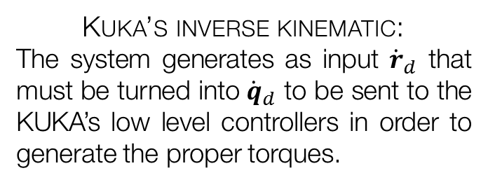

Teleoperation task
The aim of the project is use the Geomagic Touch (master) to simulate the teleoperation of a KUKA LWR 4+ (slave).
At each time-step, given the right desired pose ${(p_{d} φ_{d})}^{T}$, the robot has to converge to it and a force feedback must be returned through the haptic device. Two main problems to be solved:
Kuka’s inverse kinematic:
The system generates as input ${\dot{r}}_{d}$ that must be turned into ${\dot{q}}_{d}$ to be sent to the KUKA’s low level controllers in order to generate the proper torques.
Teleoperation schemes:
Three possible schemes have been developed in order to verify which one is more suited to a needle insertion task.
The system has been used to perform a needle insertion task, perforating a synthetic tissue modelled in the scene.

Slide 11
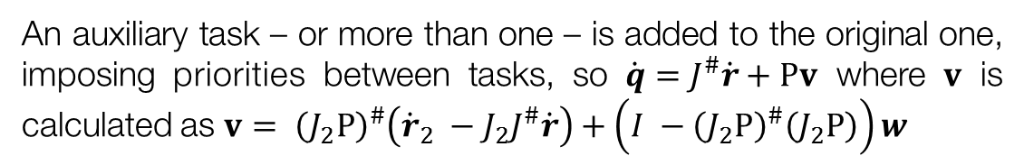
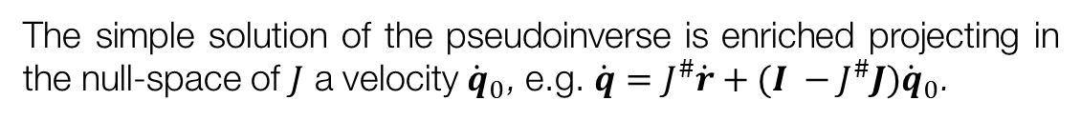
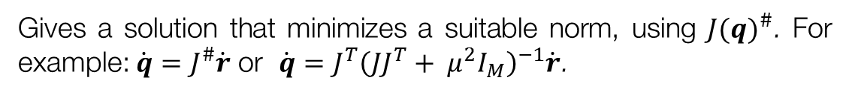


Kuka lwr 4+ inverse kinematics (1)
Inverse kinematics of a redundant manipulator can be solved using different approaches.
Starting from $\dot{r}=J(q)\dot{q}$
Jacobian-based Methods
Gives a solution that minimizes a suitable norm, using ${J(q)}^{\#}$. For example: $\dot{q}=J^{\#}\dot{r}$ or $\dot{q}=J^{T}{\left(JJ^{T}+ μ^{2}I_{M}\right)}^{−1}\dot{r}$.
Null-space Methods
The simple solution of the pseudoinverse is enriched projecting in the null-space of $J$ a velocity ${\dot{q}}_{0}$, e.g. $\dot{q}=J^{\#}\dot{r}+(I −J^{\#}J){\dot{q}}_{0}$.
An auxiliary task – or more than one – is added to the original one, imposing priorities between tasks, so $\dot{q}=J^{\#}\dot{r}+Pv$ where $v$ is calculated as $v= {\left(J_{2}P\right)}^{\#}\left({\dot{r}}_{2} −J_{2}J^{\#}\dot{r}\right)+\left(I −{\left(J_{2}P\right)}^{\#}\left(J_{2}P\right)\right)w$
Task augmentation Methods
In the system in analysis has been used a null-space based method to evaluate the right $\dot{q}$ that we provide as inputs of the KUKA low-level controllers.

Slide 12


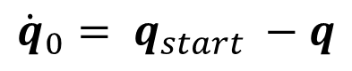
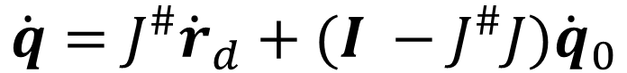
Kuka lwr 4+ inverse kinematics (2)
In order to achieve smooth movements of the slave robot, it has been decided to discard the default VREP’s IK group and to implement the following custom null-space-based IK.
$$\dot{q}=J^{\#}{\dot{r}}_{d}+(I −J^{\#}J){\dot{q}}_{0}$$
$${\dot{q}}_{0}= q_{start} −q$$
${\dot{r}}_{d}= \left({v_{d} \atop ω_{d}}\right)+ K_{p}e_{cartesian}=\left({v_{d} \atop ω_{d}}\right)+ K_{p}\left({p_{d}−p \atop T_{xyz}\left(φ\right)[φ_{d}− φ]}\right)$
Where $v_{d}$ and $ω_{d}$ are the references, while the term $e_{cartesian}$ is necessary to force the convergence of KUKA’s end-effector to the desired pose.

Slide 13
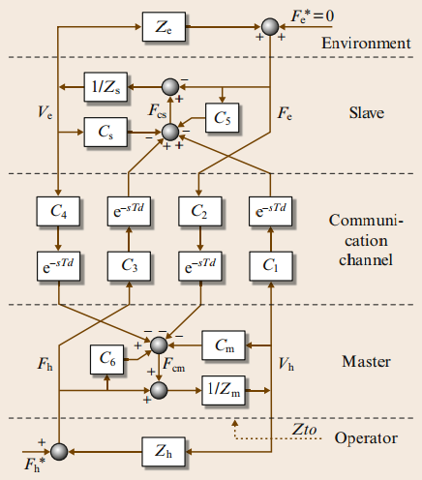
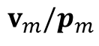
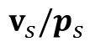
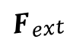

Teleoperation schemes (1)
Once that the system is able to generate desired pose references and that the slave is able to converge to them, a force feedback must be returned to the haptic device.
User
Master Velocities
$$F_{MC}$$
$$v_{m}/p_{m}$$
Teleoperation
Scheme
Inverse Kinematics
Environ.
$$F_{ext}$$
$$v_{s}/p_{s}$$
Slave Motion
Slave Velocity
Slave Torques

Slide 14
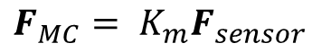
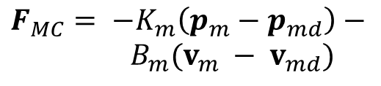
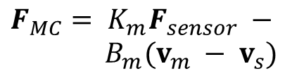
Teleoperation schemes (2)
The system developed allow the user to choose between 3 teleoperation schemes:
Position – Force/Position
Position - Position
Position - Force
Very popular among the schemes.
It allows to feel the robot while moving and the external forces.
Simple and stable method: master and slave try to track each other.
User feels only the friction and inertia in the slave robot.
Gives a more clear sense of the environment.
The user feels only the external forces that act on the slave robot.
$$F_{MC}= K_{m}F_{sensor} −$$
$B_{m}(v_{m} − v_{s})$
$$F_{MC}= {−K}_{m}\left(p_{m}−p_{md}\right)−$$
$B_{m}(v_{m} − v_{md})$
$$F_{MC}= K_{m}F_{sensor}$$

Slide 15


Teleoperation: filtering velocities
CHAI3D synchronizes Geomagic’s HL and VREP simulation loop, but velocity measures remain noisy: filtering is needed in order to generate smooth force feedbacks.
A low pass filter has been developed and used to filter the velocity measures used in the calculation of $F_{MC}$.
Weighted Average of velocity buffer
Actual Low-Pass Filter

Slide 16
Synthetic tissue (1)
In order to perform the needle penetration it has been designed in VREP a model of a generic stratified biological tissue.
4 Layers stacked to compose the Tissue:
Skin
Fat
Muscle
Bone
Analytical model used to design the tissue response to penetration. Viscoelastic force generated during insertion; force generated by:
Springs
Dampers
Initially the layer deforms itself, due to its elasticity: the force exerted on the needle is described by a spring model.
Reached the maximum deformation, perforation happens: from now on, the force is only due to viscous friction.

Slide 17
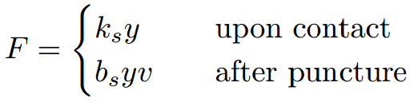
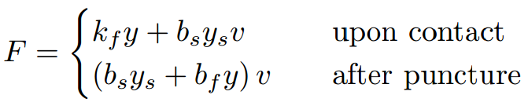
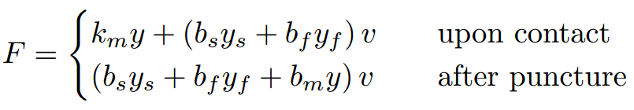

Synthetic tissue (2)
Each layer has different physical parameters to generate a more realistic effect during the execution of the task.
Skin
Fat
Muscle
Bone
Since VREP is not good in managing contacts between objects, it has been done an approximation to determine the fracture point: each layer will be perforated when a certain depth is reached – indicated through the parameter called perforation depth.

Slide 18
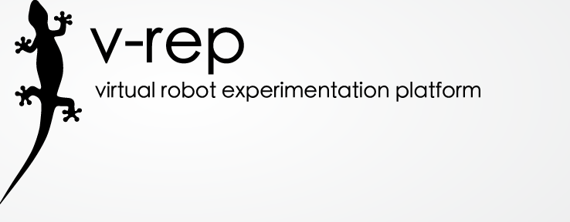
V-REP (http://www.coppeliarobotics.com/)
Free, open-source, multi-platform robotics simulator
Provides engines for dynamic/physics simulations
Many robot models are available in the standard distribution
It’s functionalities can be extended using many programming languages (C/C++, Matlab) and programming approaches (remote clients, plugins, ROS nodes)
In our approach, we developed a C++ plugin in order to perform needle penetration simulation.

Slide 19
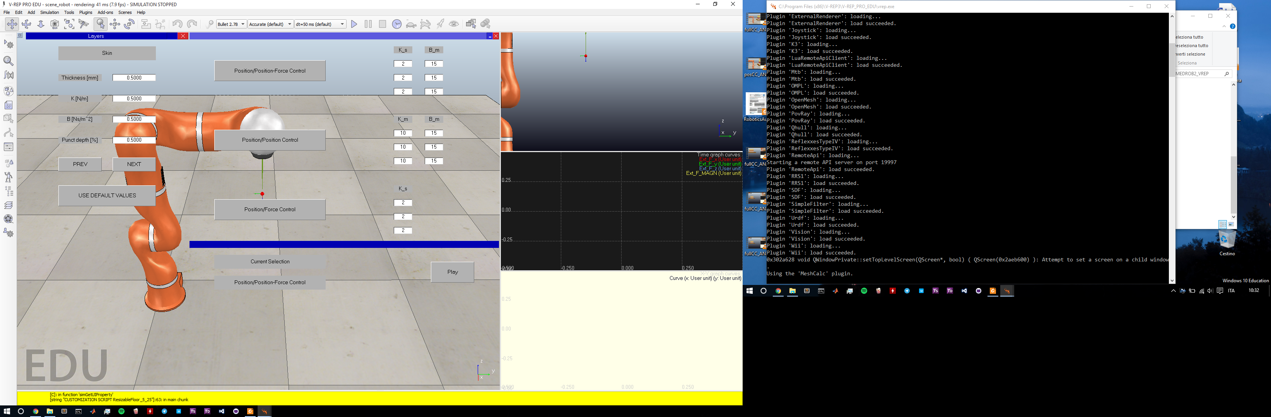
Interfaces (layers)
The user is able to chose the parameters of the 4 layers
Using the PREV/NEXT buttons the tab will switch between the layers
If the user doesn't want to fill all the layers’ parameters, he can use the default values we set on the code
Once the choice is done, the user can close the window and switch to the following interface

Slide 20
Interfaces (controller)
Through this interface the user can select and set the parameters of a controller
The current selection will be shown on the bottom section of the GUI
Thanks to the “Play” button the simulation will start with the desired parameters

Slide 21
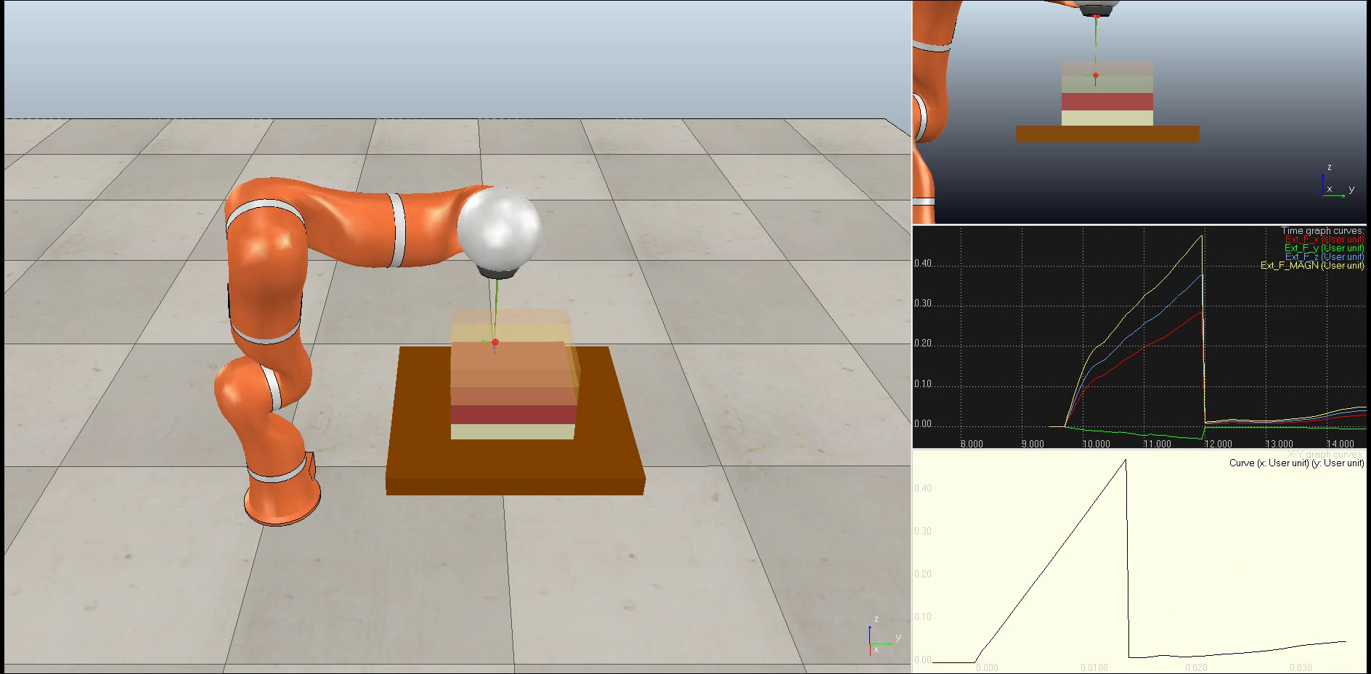
Views
Arbitrary view
Side view
External forces graph
Depth/forces graph

Slide 22
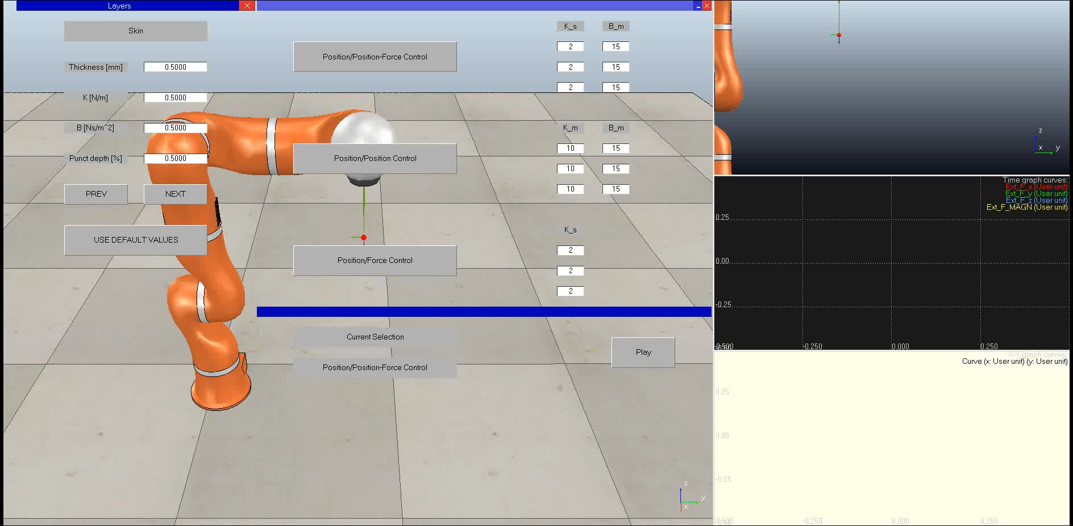
Virtual Coupling
The device’s workspace is too small with respect with the scene
With lower resolution the device’s workspace will increase in dimension, but precision in simulation will be worse
The solution is to implement clutching through virtual coupling

Slide 23

Penetration

Slide 24
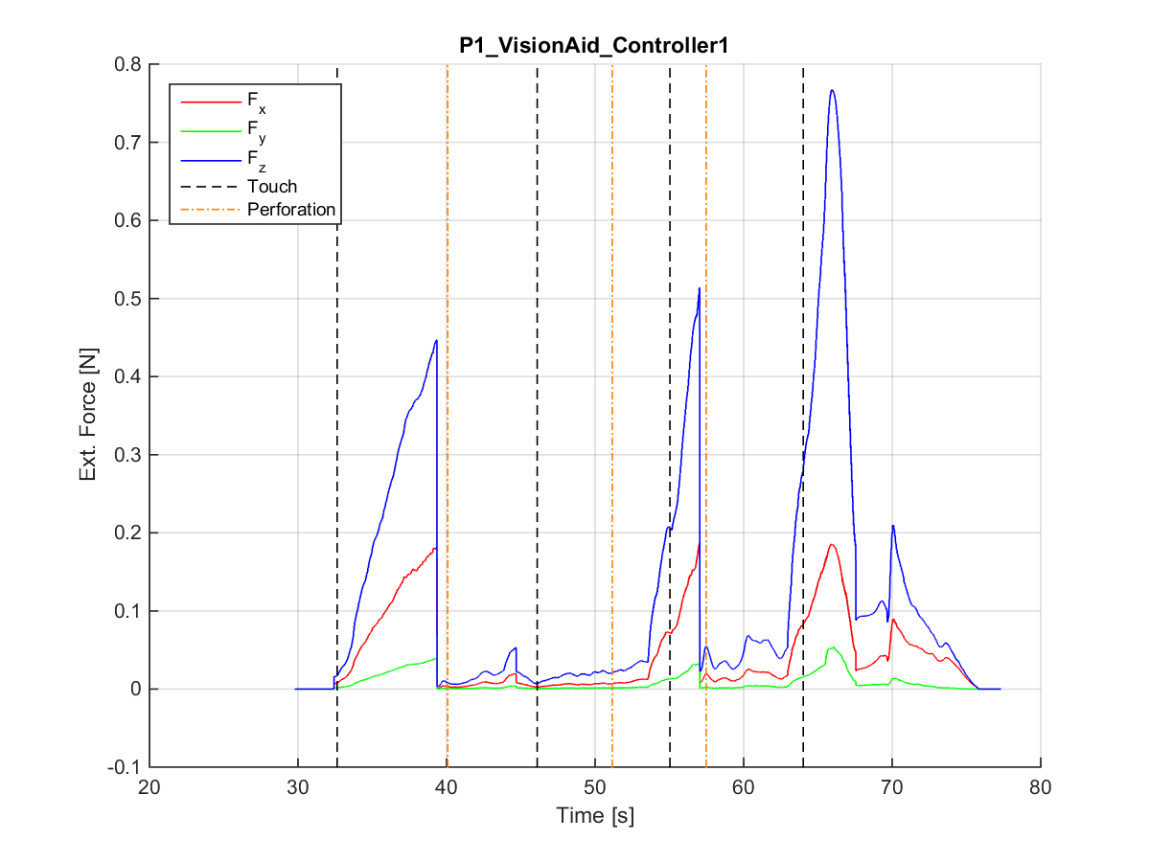
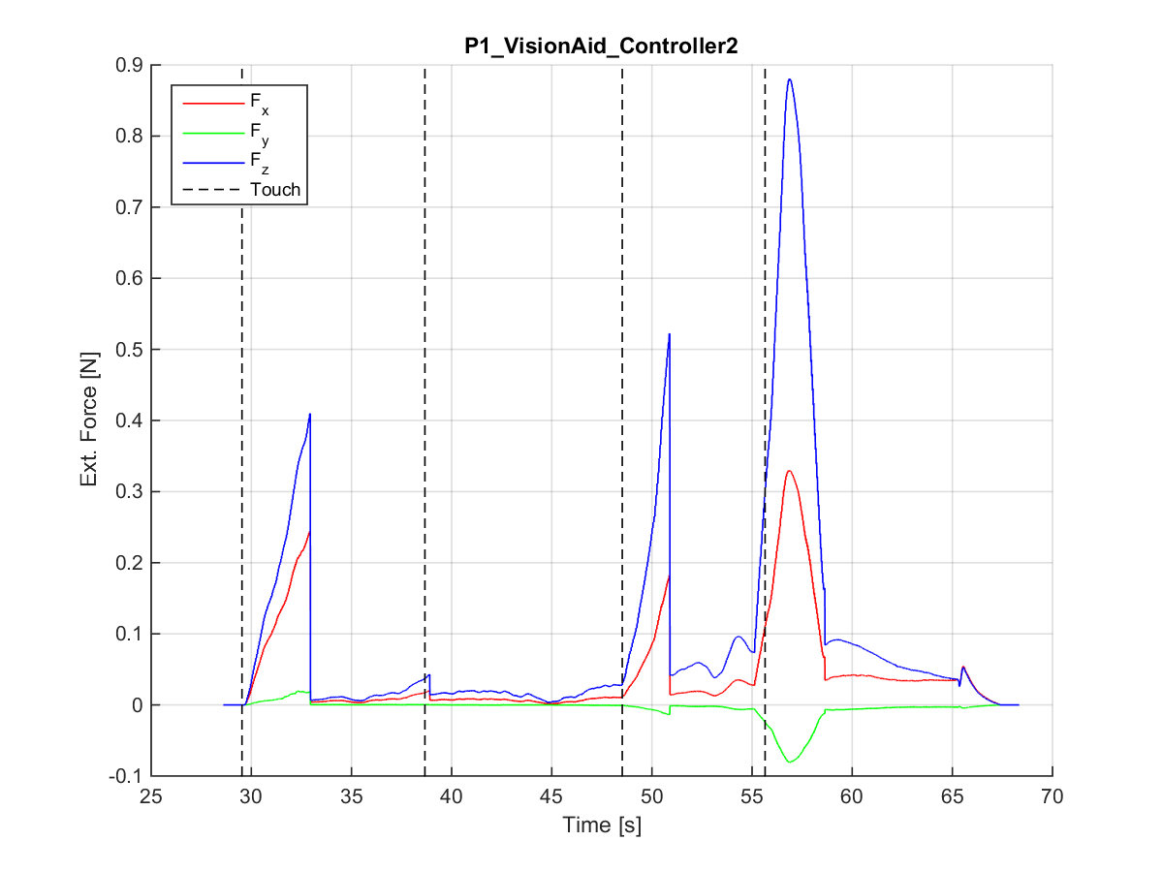
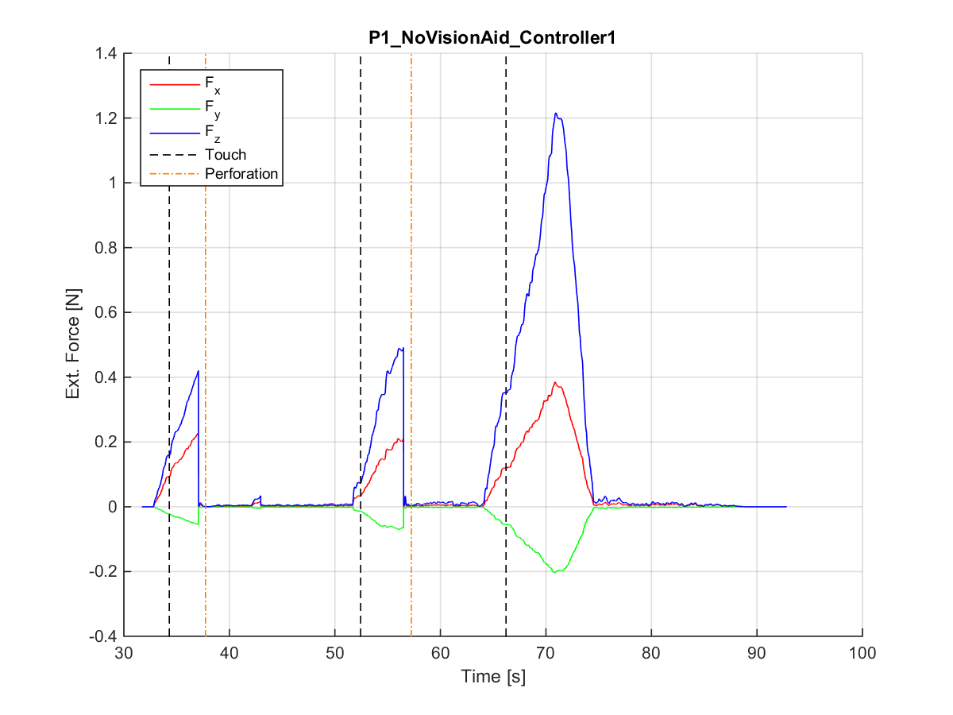
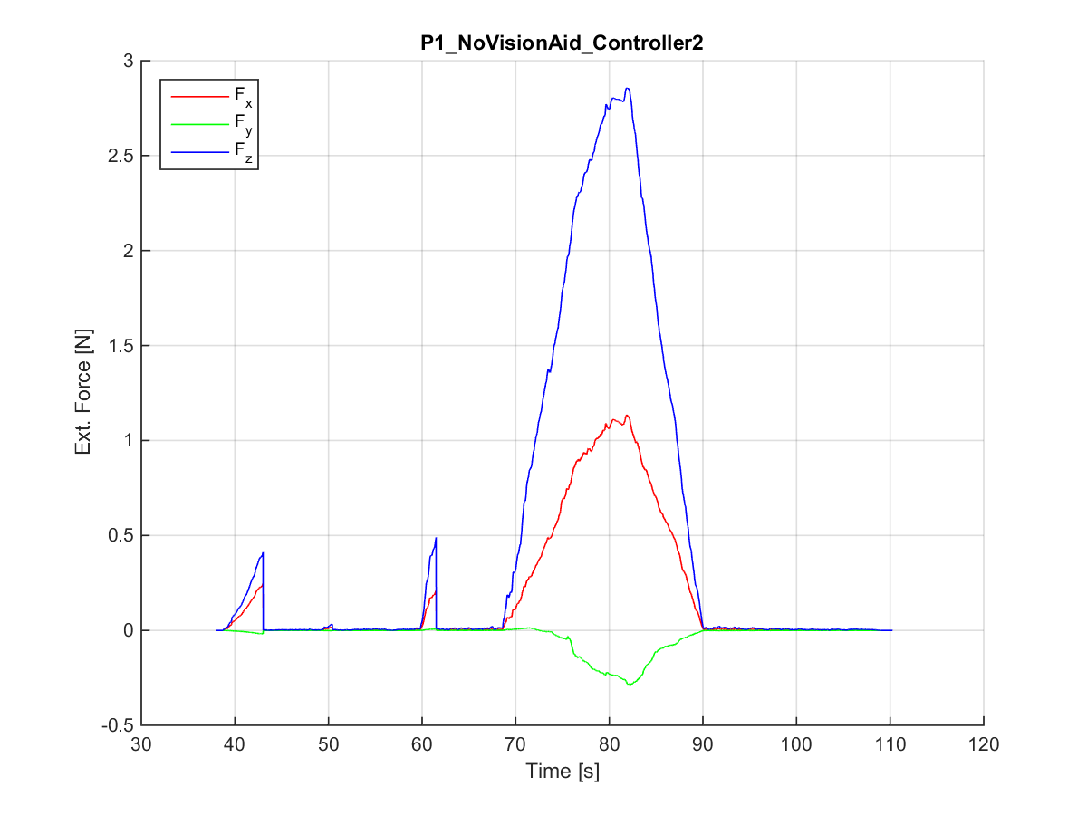
Simulations
TASK: complete penetration of the tissue and recognition the layers
Comparison between vision aided and haptic feedback only simulations with different teleoperation schemes

Slide 25
Discussion and Future Works
The aim of this project is to build a simulative framework in VREP in order to teleoperate a KUKA LWR 4+ robot using a Geomagic Touch as master robot implementing different teleoperation schemes
The experiments underlined how some of the proposed teleoperation schemes are not suitable for such tasks
VREP is not able to properly manage interactions between objects → different platform, e.g. Unity
The device has a passive gimbal so cannot provide forces on its last 3 joints → a more professional haptic device allows users to perceive more realistic sensation
This work can be transposed in real-word applications using a robot manipulator to accomplish this task

Slide 26
Thank you for your attention!

